Slide 1

Factoring Based Cryptosystem- RSA

Slide 2

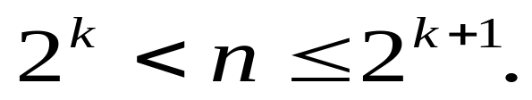
Factoring-based Cryptosystem-RSA
The RSA scheme is a block cipher in which the plaintext and ciphertext are integers between 0 and n-1 for some n.
The scheme is developed by Rivest, Shamir, and Adleman makes use of an expression with exponentials.
Plaintext is encrypted in blocks, with each block having a binary value less than some number n.
In practice, the block size is bits,where

Slide 3
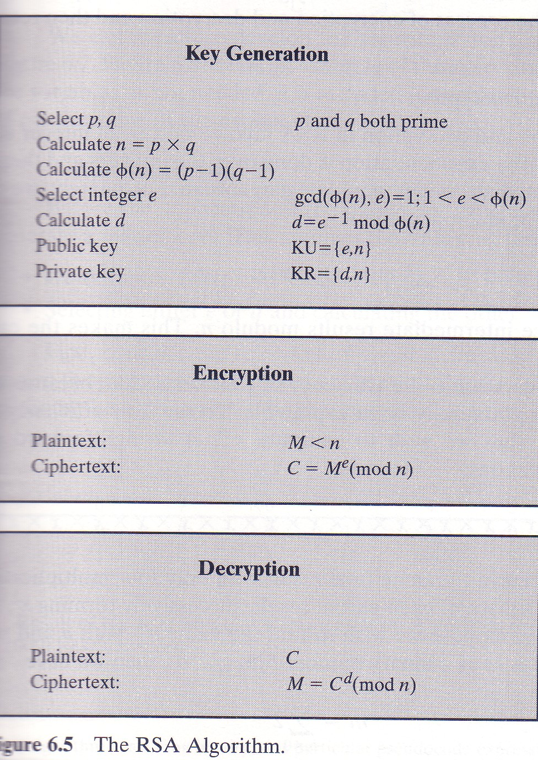
RSA Algorithm

Slide 4
RSA Algorithm
A B
Public Key nA=pA*qA nB=pB*qB
eA: encryption key eB:encryption key
Private Key dA: decryption key dB: decryption key
dA= eAˉ¹ mod φ(nA) dB= eBˉ¹ mod φ(nB)
=> dA eA mod φ(nA)=1 dB eB mod φ(nB)=1
pA and qA pB and qB
Note: p and q are large primes.

Slide 5
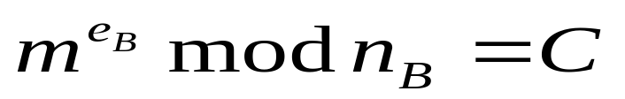
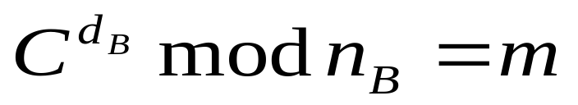
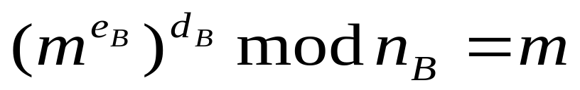
RSA
Secret communication:
Let’s say that we want to send a secret message (m) from sender (A) to receiver (B).
A B
m
Encryption:
Decryption:
=>

Slide 6
Security of RSA
dB eB mod φ(nB)=1.
Let’s assume that attackers know the eB and nB. It is still hard for attackers to find φ(nB) because attackers do not know pB and qB. Therefore, attackers cannot find dB with knowing the eB and nB only. Without knowing the dB, attackers cannot break the ciphertext.

Slide 7
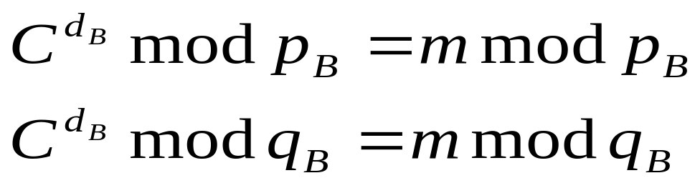
Security of RSA
Under know/chosen plaintext attack, the attackers know C, nB and m to solve dB from above equation, attackers need to first solve the discrete logarithm problem of
and then apply the Chinese Remainder Theorem to find dB. So, the attackers still need to first solve the factoring problem, and then solve the discrete logarithm problem.

Slide 8
Security of RSA
The factoring problem is computationally infeasible to break.
So far, we still not sure the security of RSA is equivalent to a factoring problem. If someday, the RSA algorithm is cracked, this may be resulted from other RSA’s weakness (i.e. not breaking the factoring problem).

Slide 9
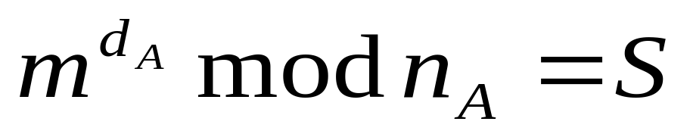
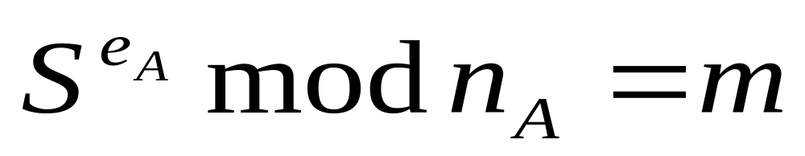
Data Authentication
A B
Encryption:
(Signing)
S: is also called the “digital signature”.
Decryption:
(Verification)

Slide 10
Data Authentication
With the digital signature, receivers can be sure that the messages are sent form the ones who are expected.
Although the digital signature is only some binary numbers, it can be used as a court evidence. Not everyone can generate the digital signature. Only the one with the “dA” can generate the digital signature.

Slide 11
RSA
Example:
p= 7, q= 17 , e=5 what will be the n, φ(n), and d.
=> n= 7*17=119
φ(n)=(p-1)*(q-1)=6*16=96
e * d mod φ(n)=1
5 * d mod 96=1
d=77 (can use Euclide’s Extended
Algorithm to find the “d”)

Slide 12
RSA
Usually, we use small e (encryption key ) to encrypt message.
With gcd(e, φ(n))=1,
where φ(n)=(p-1)(q-1), and
p=2p′+1, q=2q′+1 (strong primes where p, p′,q,q′
are primes)
then φ(n) = 4p′ q′ .
The smallest prime number for satisfying gcd(e, φ(n))=1 is 3
So, the smallest e is 3.(only takes 2 modulo multiplications)
Users can commonly use e = 3 as public key but d (decryption key) will be different.
=> d should be as large as possible (for security reason).

Slide 13
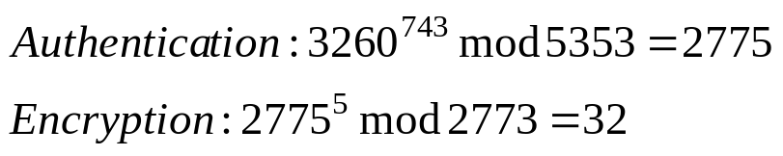
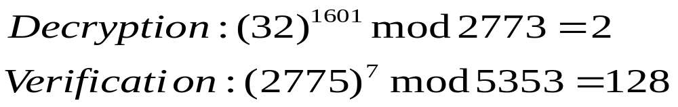
Encryption and Authentication
Example: (Note: This is a wrong way to do)
A m=3260 B
(eA , nA) (eB, nB)
=(7, 101*53) =(5, 59*47)
dA=743 dB=1601
Let’s do the authentication first.
Sender side:
Receiver side:

Slide 14
Encryption and Authentication
(Continue)
As we can see that the message cannot be recovered back to the original message (m=3260).
This is because the nA is larger than nB, we cannot recover the message (i. e, 2775 is larger than 2773, and 2775 cannot be recovered in the decryption).
Therefore, when we are doing the “Encryption and Authentication”, we always have to compare nA and nB first.

Slide 15
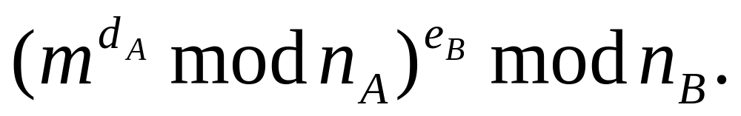
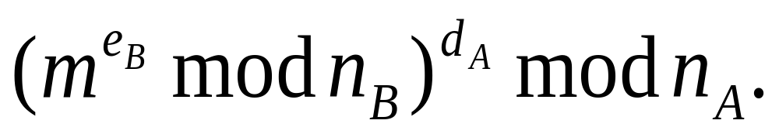
Encryption and Authentication
(continue)
=>When the message is sending from A to B and nA is smaller than nB, then do the following
If nA is larger than nB, then do the following

Slide 16
Chinese Remainder Theorem
X= a1 mod n1
= a2 mod n2
= . .
= . .
= aT mod aT
where n1, n2,…………………nT are pair- wise relative prime,
and N= n1* n2*…………………*nT,

Slide 17
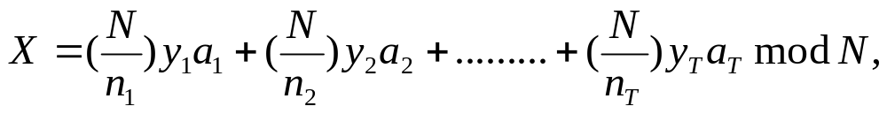
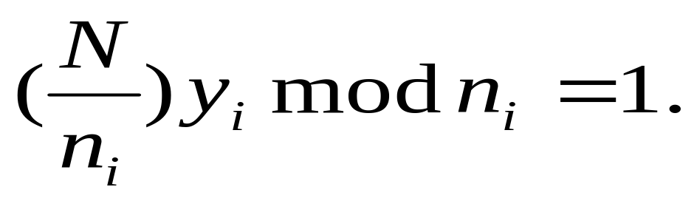
Chinese Remainder Theorem
(Continue)
The solution is
where

Slide 18
Chinese Remainder Theorem
Example: Find the X such that x satisfies the following equations:
X=2 mod 3
X=3 mod 5
X=2 mod 7
Solution:
N=3*5*7=105
35 y1 mod 3=1 => y1=2
21 y2 mod 5=1 => y2=1
15 y3 mod 7=1 => y3=1
So, X=(35*2*2)+(21*1*3)+(15*1*2) mod 105=23.

Slide 19
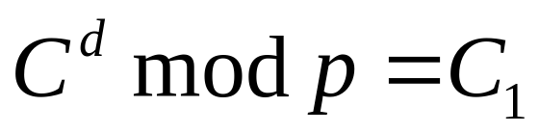
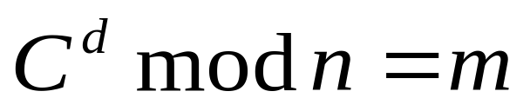
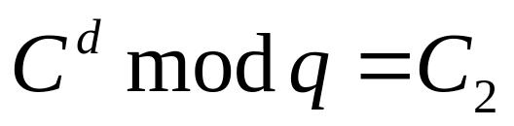
Application of Chinese Remainder Theorem
Example: 17¹³ mod 21
p=3, q=7
n = p * q = 21
First, Find C₁ and C₂ such that
17¹³ mod 3=2¹ mod 3=2
17¹³ mod 7=3¹ mod 7=3. Then, find X satisfies
X=2 mod 3, and
X=3 mod 7
Using CRT => X=17

Slide 20
Application of Chinese Remainder Theorem
For example, we assume that p and q are 250 bit each. Then to compute
needs 750 A*B mod n (modulo multiplications) and each operand is 500-bit long.

Slide 21
Application of Chinese Remainder Theorem
To compute
needs 2*375(=750) A*B mod n (modulo multiplications) and each operand is 250-bit long. Since 500-bit operand multiplying 500-bit operand can be accomplished through 4 steps of 250-bit operand multiplying 250-bit operand, using CRT can speed up processing by 4 times.
Note: although CRT needs 2 extra multiplications, these extra multiplications can be almost ignored.

